Slide 1
INKREDIBLE:
Case 1.3: Helping readers judge the credibility of media
TEAM F:
Isaac Ng; Emily Law; Chu Jeng Kuen;
Nicholas Andika; Hoon Wei Ting

Slide 2
Mission Statement
Provide better clarity
to the credibility of
news found online

Slide 3
Problem Statement
How might we better manage the rising tide of misinformation that is threatening to drown the nation?
Considerations:
Target audience
Type of misinformation to target
Original and Considerations
Notes:
Target audience: Internet users (Main medium that misinformation spreads in)(How many times have we seen unreliable newspapers?)
Type of misinformation to target: Websites (Main source of misinformation online)

Slide 4
Problem Statement
How might we equip users with the ability to judge the credibility of media they consume, in order to minimise the impact of fake news?

Slide 5

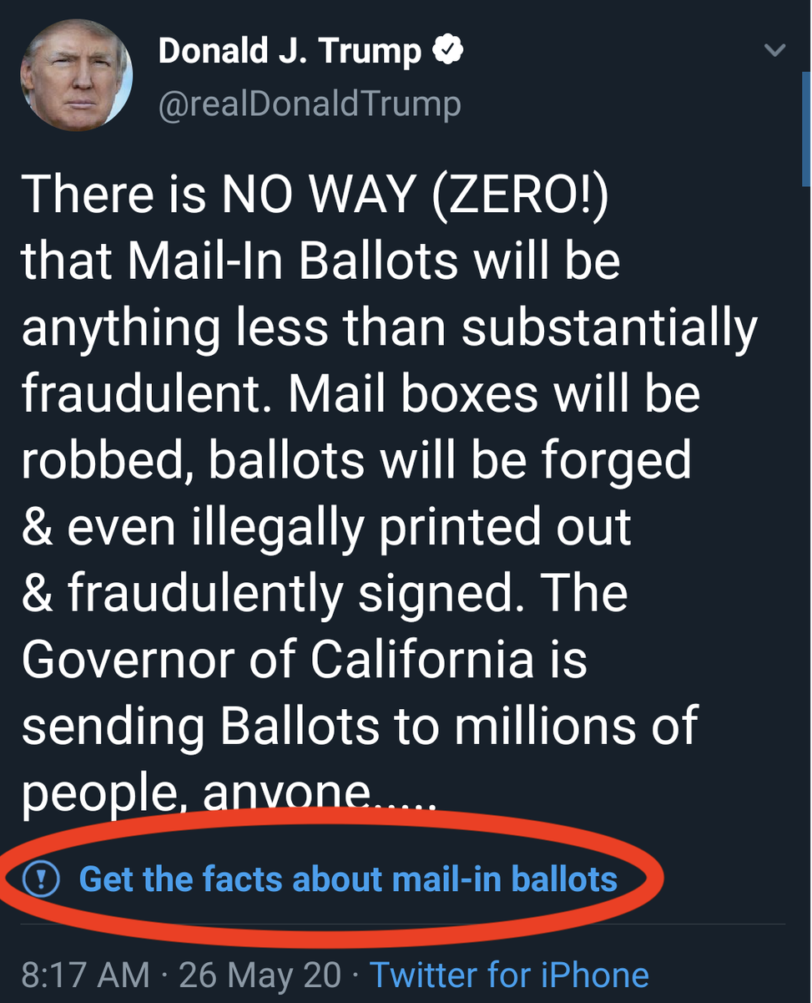

Existing Solutions
POFMA
Twitter fact-check labels
Education
Notes:
POFMA: regulation imposed by the singapore government
education of the public
REAL WIN WORTH ITTTTTTTTTTTTTTTTT

Slide 6

Our Solution: Inkredible
Description:
An incredible web extension to verify the credibility of web pages the users visit
Features:
Verified label
Shows that a website is a verified source
Shows source of verification
Split comments
Shows opposing points of view
Fact vs Opinion
Shows facts from opinions

Slide 7
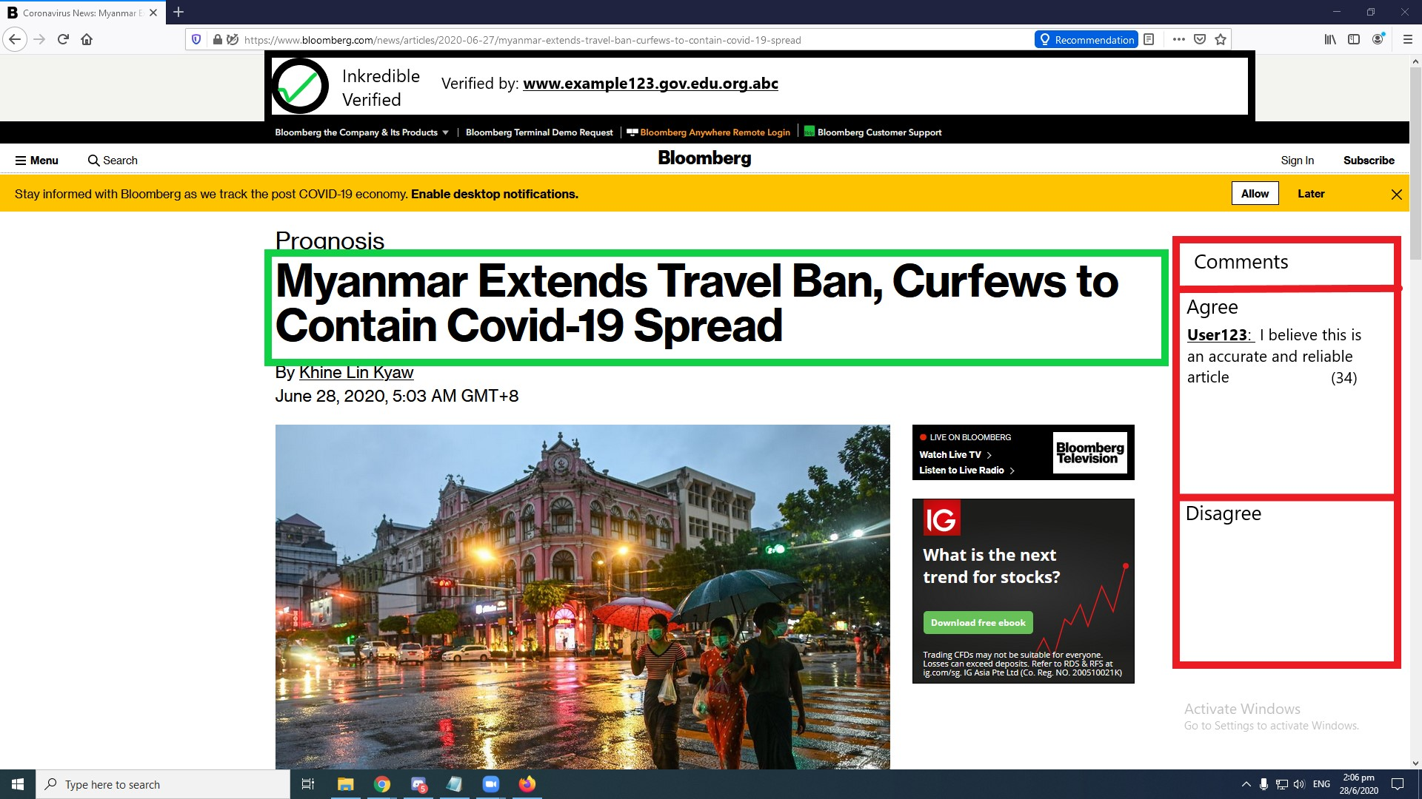

Slide 8
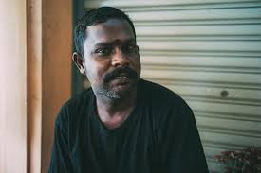
User Persona
Haziq, 30, Male, Engineer
New father of a 1 year-old daughter
Avid consumer of news
Hectic lifestyle
Needs/ Concerns:
How Covid-19 can affect his child’s health and growth
Needs an efficient and fast way to know which article is reliable
Notes:
Concerned about how Covid-19 can affect his child
Needs/ Concerns:
, needs to know if his sources of news are reliable
Concerned about his child’s health and growth of his child during the pandemic period, having to do most activities at home
Has less time than before to keep up with the news, and needs
Challenges:
Unable to discern between reliable and shady articles on the internet
Unsure of what advice to follow to keep his child healthy

Slide 9
User Journey Map (Before)
Haziq reads an article online
Makes use of inkredible
Scans through article comments
Reads simple overview of other readers’ opinions on the article
Does not analyse reliability and credibility of article
Verified label is displayed if article is reliable
Decides whether he accepts the information presented
Easily confirms article’s information is acceptable
Notes:
Haziq is using the internet, sees an article that catches his eye,
this might cause him to become a victim of fake news

Slide 10
User Journey Map (After)
Haziq reads an article online
Makes use of inkredible
Scans through article comments
Reads simple overview of other readers’ opinions on the article
Does not analyse reliability and credibility of article
Verified label is displayed if article is reliable
Decides whether he accepts the information presented
Easily confirms article’s information is acceptable

